Slide 1
SQE implementation
Zoe Robinson, Director of Learning and Qualifications, Kaplan Professional UK
Yiannis Chrysanthou, Head of Stakeholder Engagement,
Kaplan SQE
Maxine Warr, Head of Education and Training, SRA

Slide 2
First SQE assessment dates
SQE1 dates for 2021:
  8 November (FLK1); and
  11 November (FLK2)
SQE2 will be in April 2022 - exact dates will be confirmed in April 2021
Next set of dates will be decided after further stakeholder engagement
Notes:
Zoe
8th is a Monday, 11th a Thursday.
Deliberate gap between the SQE1 days for the candidates’ benefit – each exam is just over 5 hours long (5 hours 6 mins to be precise, split into 2 halves, with an hour’s break in the middle. Some additional time for a pre-exam tutorial, signing declarations etc and each day in total will be approaching 6.5 hours long. We therefore felt a gap was important.
Stakeholder engagement will start after this conference – we’ll circulate a survey and would encourage you all to complete. In October 2019 stakeholders provided us with very helpful feedback in relation to possible SQE assessment timings. As we mentioned at the time, the initial sittings of SQE1 and SQE2 are most likely to be slightly different from subsequent years to balance various factors, including the provision of appropriate assessment sittings for the first cohort of solicitor apprentices. Now that the SQE has been approved by the LSB, and training providers and employers will be more advanced in their course, training and recruitment planning, we would like to seek your further feedback on subsequent SQE timings that would become the regular pattern for the SQE assessment. We absolutely recognise the importance of that consistent pattern of windows – you need certainty to allow for recruitment and course planning and the aim of this survey is to help us give that to you.
It also contains some questions about anticipated volumes – again, this is really important information to help us plan to ensure sufficient capacity in the system. All responses will be treated confidentially and will only be used to assist us in our planning.

Slide 3
SQE assessment venues
SQE1 assessment venues
  Pearson VUE test centre network
SQE2 assessment venues
  April 2022: London, Manchester, Cardiff
  At least two additional venues added over time, based on demand
Notes:
Zoe
Anything we can say about PV network?
SQE2 – all central locations near to major transport hubs.

Slide 4
SQE website
Going live in early summer 2021
One easily accessible and dedicated source of SQE-related information
Access to the SQE portal to follow shortly after
  Candidate registration
  Bookings
Notes:
Yiannis

Slide 5
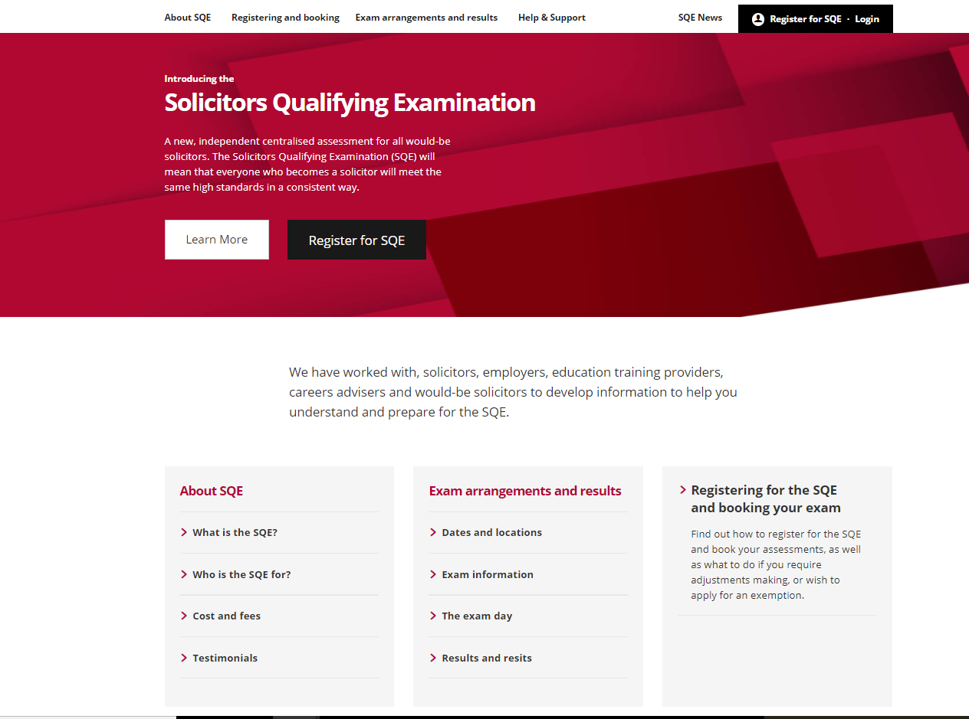
SQE website landing page
Notes:
Yiannis

Slide 6
Registration
Individuals will register as a candidate on the SQE portal
Candidates will create their SQE profile
Enter personal details, answer diversity questions, provide identification

Slide 7
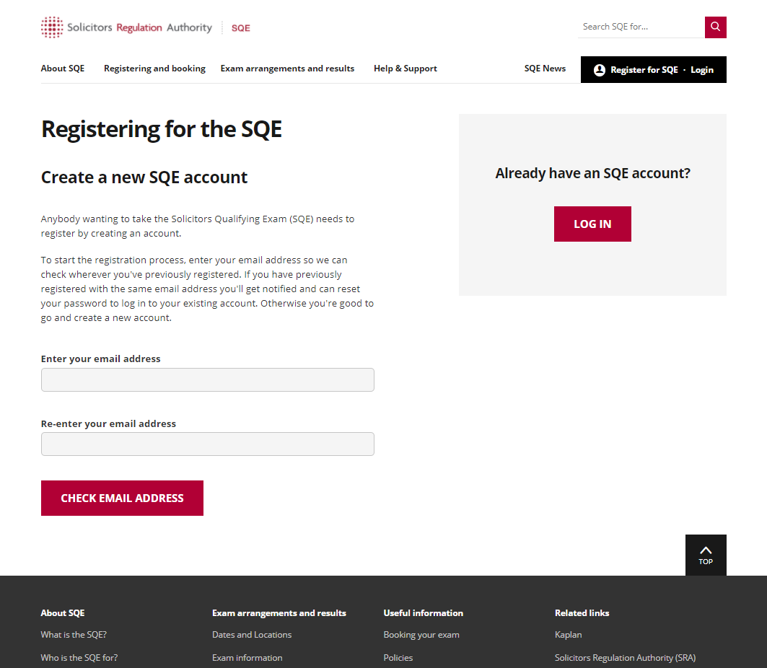
Registering for the SQE

Slide 8
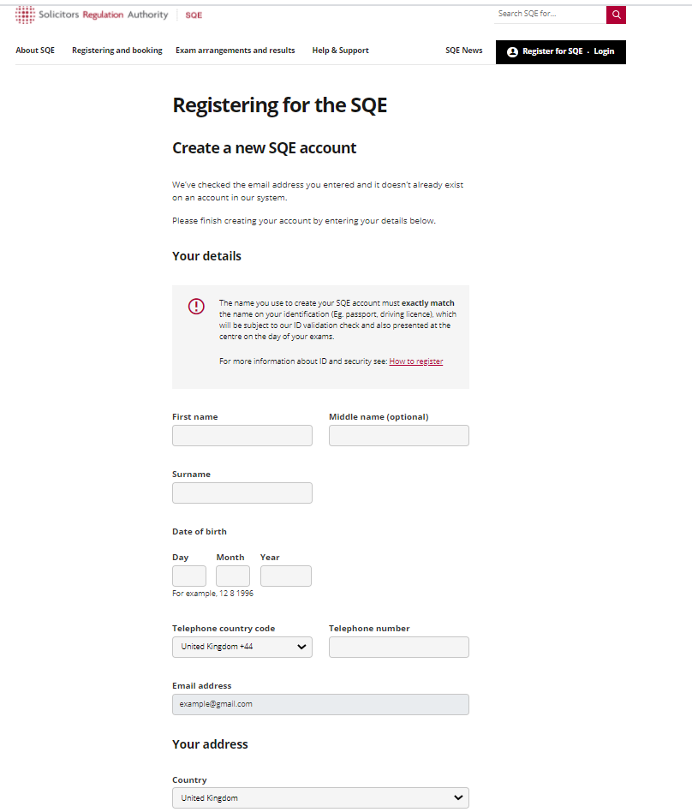
Registering for the SQE

Slide 9
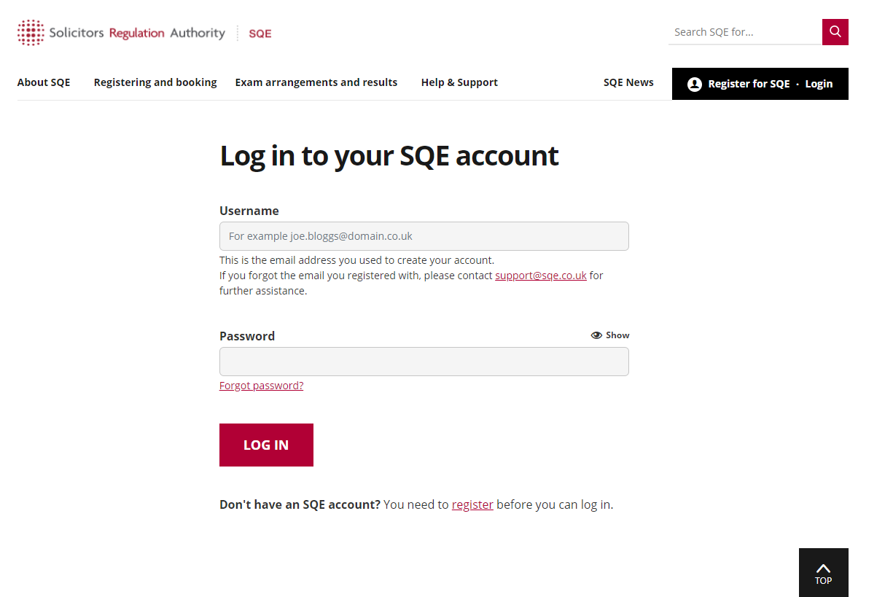
SQE candidate account

Slide 10
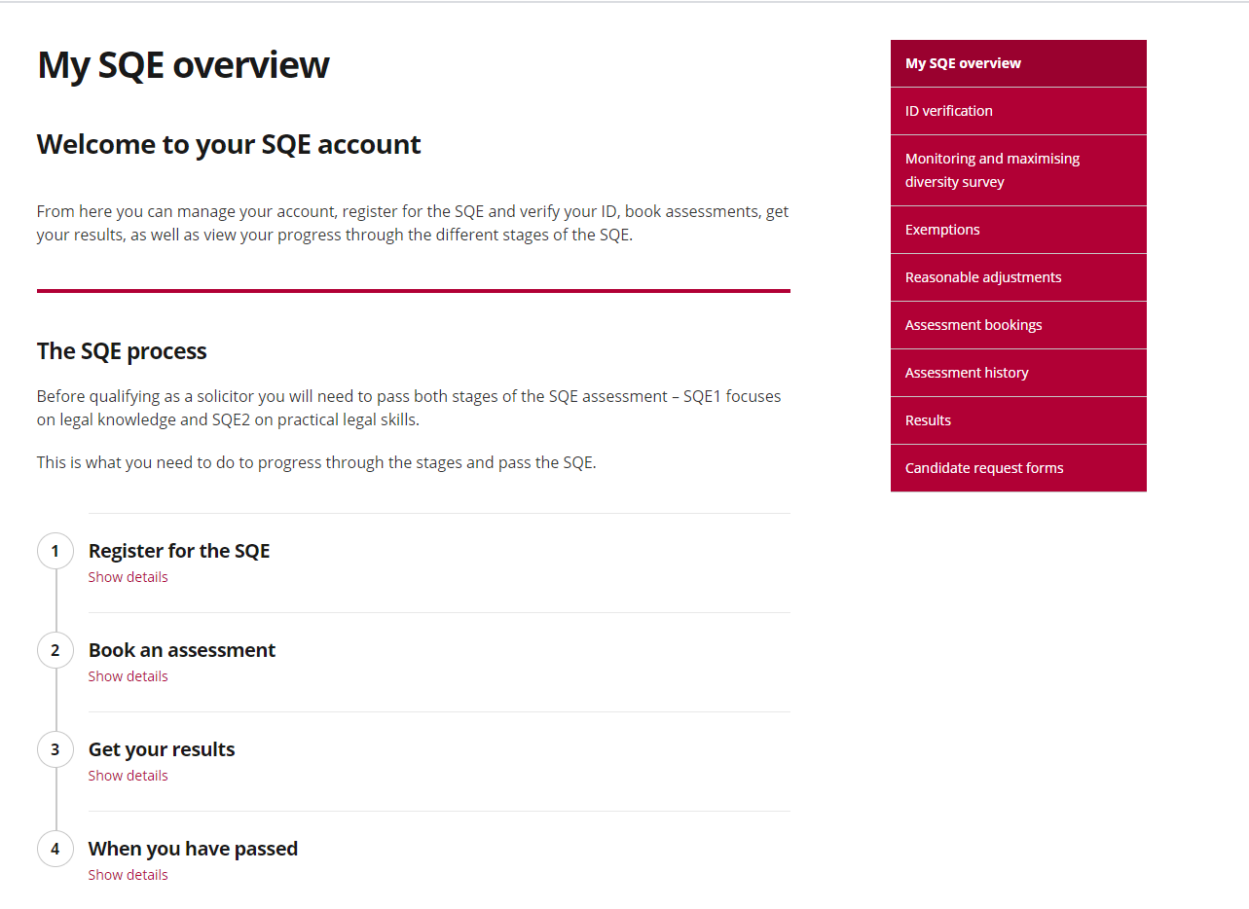
SQE candidate account

Slide 11
Booking assessments
Candidates
  Book assessments via the SQE portal
  Process
Third party bookings
  Eg employers and training providers
  Process

Slide 12
Booking timings and administration
Generally
  bookings open approx. 18 weeks before the assessment
  close approx. 8 weeks before the assessment
SQE1 November 2021
  bookings open approx. 14 weeks before the assessment (early July 2021)
  close approx. 6 weeks before the assessment (end Sep 2021)

Slide 13
Booking timings and administration
SQE2 April 2022:
  bookings open approx. 12 weeks before
Candidate assessment administration information

Slide 14
Results
Candidate notified via email that results are available
Candidate logs in to the portal to view results
Not sent to third parties (other than for apprentices)
Timing of results
Notes:
SQE1: approx. 8 weeks after the end of the assessment
SQE2: approx. 14 weeks after the end of the assessment
Please note, these timings are still subject to confirmation, especially for SQE1 as we’re conscious Christmas will have to factor into the equation.

Slide 15
Delivery methods and Covid-19
“The exam was very well run & I felt safe from a Covid-19 perspective”
Delivering current model is the priority
Can be delivered socially distanced
QLTS 2020 success:
  July MCT
  July/August OSCE
  November OSCE
“I’d like to extend my gratitude to the team. They’ve done a great job making the exam happen as scheduled. It was an amazing achievement & set a model example for other businesses under the current circumstances”
Notes:
It’s understandable that we and the SRA have received questions about the delivery of the SQE in a global pandemic. As expected, the LSB also asked a number of questions in this area.
The current planned assessment delivery, as laid out in the assessment specification remains our priority – it is the fairest, most reliable, accurate and secure way to delivery the exams, with or without social distancing.
And we’ve demonstrated it can be done. Since lockdown in March we have successfully delivered socially distanced versions of both the QLTS MCT and OSCEs. I’m proud to say that every candidate who has been willing to sit an OSCE since lockdown has been able to and we’ve received some fantastic feedback from candidates on our approach. TfL comment
Our MCT in January look set to have more candidates sitting the exam than we’ve ever had before – nearly 50% more, and this is whilst operating within social distancing restrictions.

Slide 16
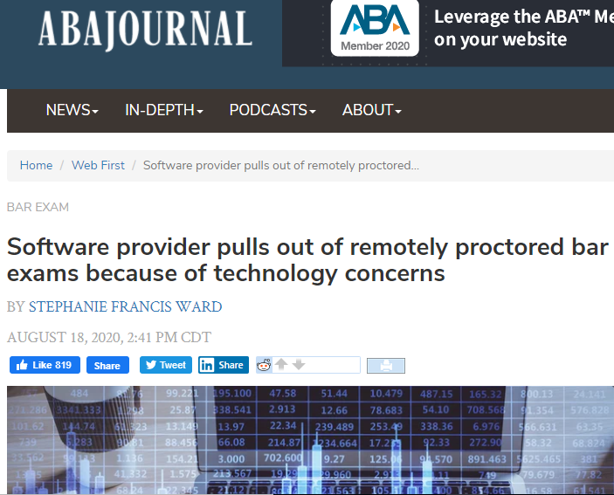
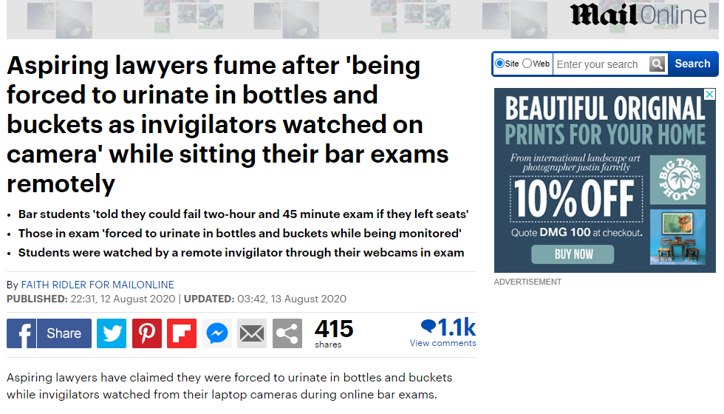
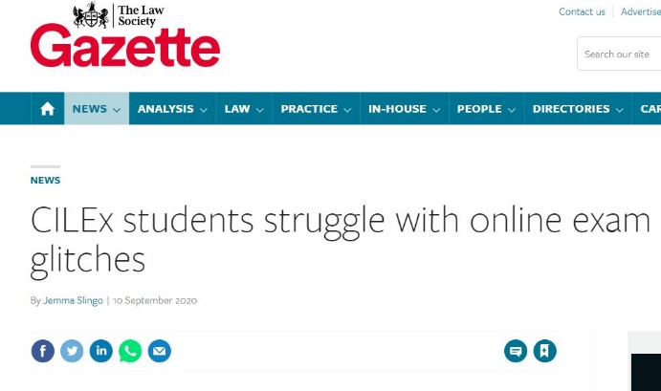
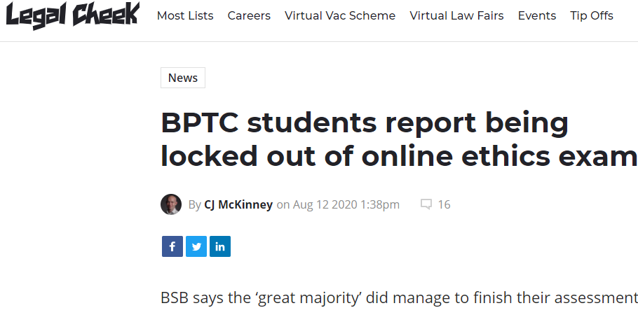
Remote proctoring issues
Notes:
As part of our business continuity planning for SCE, we are of course investigating remote proctoring. But it is not without it’s challenges, as evidenced by these articles, just a few of many that have appeared this year. The Bar Standards Board issues even made the national press
There are possible discriminatory challenges, be that meeting the needs to candidates with disabilities or specific reasonable adjustments or racial issues where it’s been widely reported about challenges with facial recognition software used in ID verification to cite just a couple. More general technology issues such as internet stability and digital poverty. Security challenges, both of the assessment itself if candidates require toilet breaks or in respect of data privacy and intrusion into candidates homes with the recording of the exam. We are exploring all of these challenges and looking at how we can overcome them but we will not proceed down this path until we are happy that the assessment would still be of sufficiently high quality and that it won’t discriminate.
We are also investigating alternative assessment models which could be deployed if needed, although we see this very much as a last resort. The GPs have taken this approach and we are not discounting it as an option but as I started out saying, we remain firmly of the belief that the assessment specification presented is the fairest and most reliable way of assessing the competence of our candidates.

Slide 17
Recruitment to SQE roles
https://kaplan.co.uk/about/solicitors-qualifying-examination/recruitment
Subject Heads | Welsh speaking Subject Heads
Head of Equality & Quality | Psychometrician
Solicitor Examiners | Equality & Quality Supervisor
Head of Academic Resources | Various operational and candidate services roles

Slide 18
Recruitment of SQE examiners
Range of freelance solicitor examiner roles
  assessment writers for SQE1, writing single best answer MCQs
  assessment writers for SQE2, writing SQE2 scenario based assessments
  assessor for SQE2 live oral advocacy assessments
  marker for SQE2, marking candidates’ written answers to SQE2 assessments
Process: expression of interest form and recruitment day

Slide 19



SQE implementation
Application forms available from spring 2020
Qualifying work experience (QWE)
Exemptions for qualified lawyers
Degree equivalent
Applications for admission from 1 September 2021
Transitional arrangements

Slide 20
Further information
Transitional arrangements - www.sra.org.uk/transitional-arrangements
Qualifying work experience for trainees – www.sra.org.uk/qwe-trainees
Principles for qualified lawyers – www.sra.org.uk/sqe-qualified-lawyers
Degree or equivalent – www.sra.org.uk/sqe-degree

