Slide 1
SQE – where we’ve got to
Julie Brannan,
Director of Education and Training

Slide 2
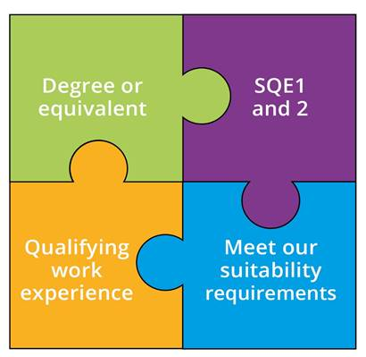
The SQE – a reminder
A single, robust, examination all aspiring solicitors will have to take
To be introduced on 1 September 2021; details of the transition to SQE are on our website
Everyone will meet the same high standards in a consistent way
We will no longer specify routes to admission as a solicitor
Notes:
SQE 2 only after passing SQE 1

Slide 3
Our work over past 12 months
December 2019: publication of SQE1 sample questions; SQE2 pilot
June 2020: publication of SQE2 final report; decision on overall assessment design
July 2020: publication of Bridge Group report and updated Equality Impact Assessment; announcement of SQE fees; publication of SQE 2 assessment specification
October 2020: SQE approved in full by the LSB
Summer 2020: revised SQE transition arrangements

Slide 4
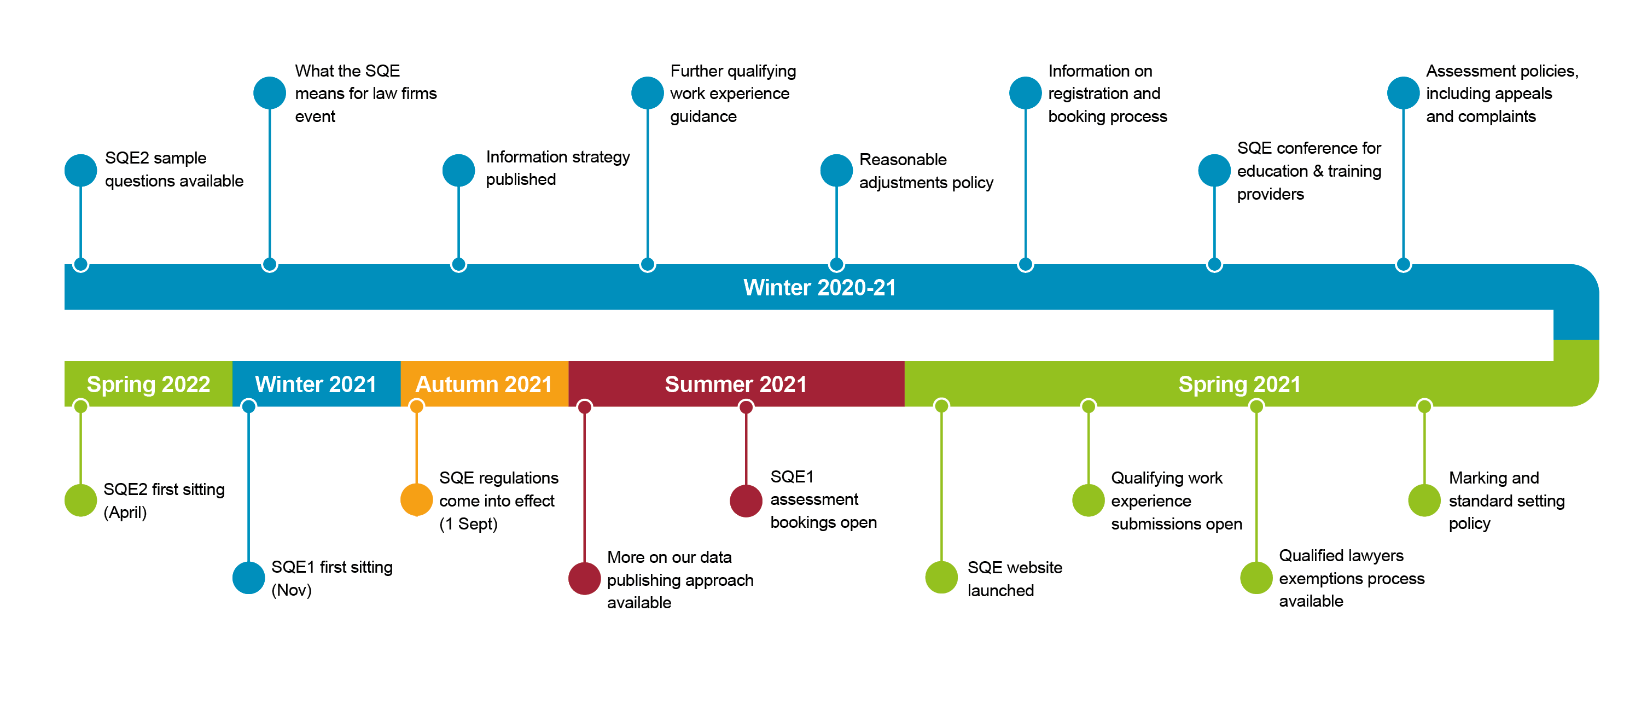
Getting ready for the first assessment

Slide 5


Action for us all – law firms
Joint responsibility to take action to realise SQE benefits:
    ‘Increasing diversity in the profession is dependent critically on the actions of employers and training providers, with actions by the SRA likely to achieve only modest gains without corresponding action from stakeholders in the sector.’
    Bridge Group
    Employers who currently employ trainees can now recruit from different talent pools and qualification routes
    Employers who don’t currently employ trainees might want to think about whether they can offer qualifying work experience

Slide 6


Action for us all – training providers
Opportunity for greater variety and choice in solicitor training:
  Traditional delivery, or online courses, or integration between classroom and work-based learning
  Short focused courses or additional learning
  The trainee or apprenticeship or paralegal models
Closer collaboration between traditional universities and providers of professional legal education and/or law firms
We want to collaborate with firms and training providers. Tell us what support you would find helpful: sqe@sra.org.uk

Slide 7



Keep in touch
Send your
queries to sqe@sra.org.uk
SQE resources
sra.org.uk/
developingthesqe
Subscribe to our monthly
SQE Update

Slide 8
Independent Reviewer – update on SQE development
Geoff Coombe

Slide 9
My role
During piloting – to review ideas, observe pilot activity and offer assurance based recommendations on the best set up of the SQE
Preparing for the first live exams
As live exams get going
Ultimately to offer independent assurance

Slide 10
Outcomes from SQE2 pilot
Useful evidence for finalising SQE2 design
Planning and operation of logistics was high quality
Recommended some detailed improvements to put in place for first live exams
My report was published in July 2020

Slide 11
Finalising the design of SQE
Informed by the SQE1 & SQE2 pilots
Review of best practice in other professional exam contexts
The academic literature supports the final design decisions
Single best answer tests for SQE1 are right for this type of assessment
The universal design for SQE2 is critical for fairness

Slide 12
SQE approval process
Interviews with the Bridge Group and Legal Services Board
Recommendations for framework and governance of quality assurance
Recommendations from my SQE1 & 2 pilot reports informed submissions of evidence to LSB

Slide 13
Preparing for first live exams
Build processes which aim to design quality up front
Review of operational plans and process documents
Observation of early training activities eg SQE question writers
Meeting with key stakeholders
Checking preparedness for live assessments

